Slide 1

Scorpians
B.T.T. De Silva--------------------(W1790006)
H.M.Yasiru Rashan---------------(W1790042)
M.P.M.A. Dharmawardhana-----(W1790366)
S.S. Kariyawasam-----------------(W1790367)
P.J.V.P.Jayasinghe----------------(W1790806)
S.N. Ramasinghe------------------(W1790161)

Slide 2
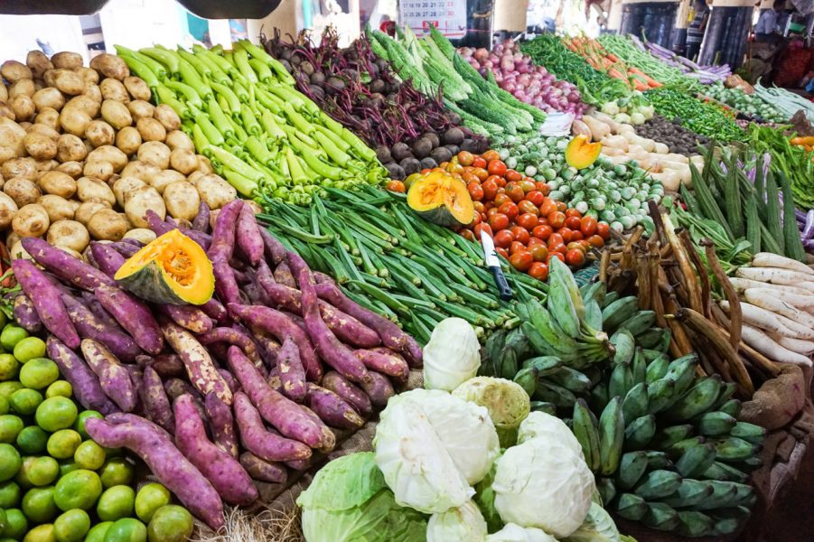
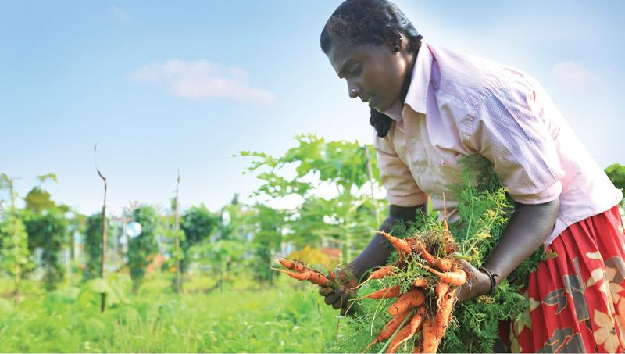
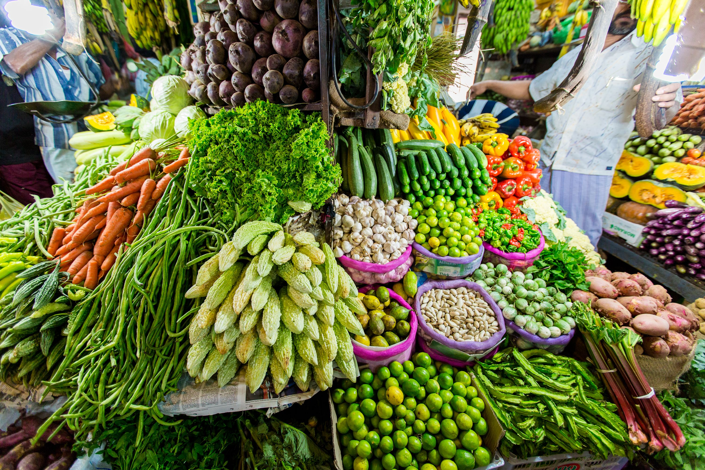
The Vegetable Market in SriLanka

Slide 3

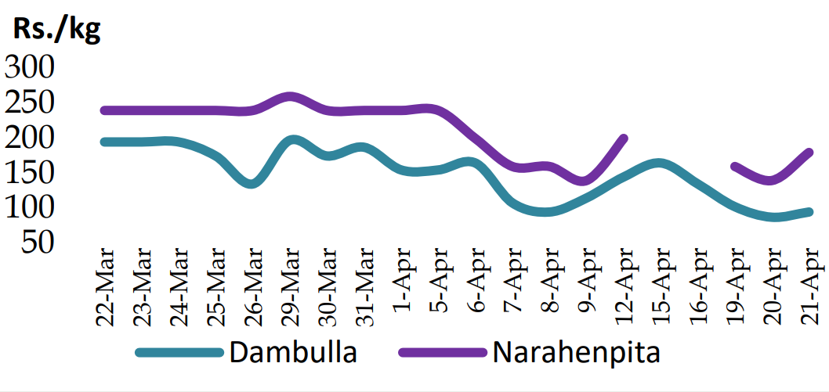

Slide 4
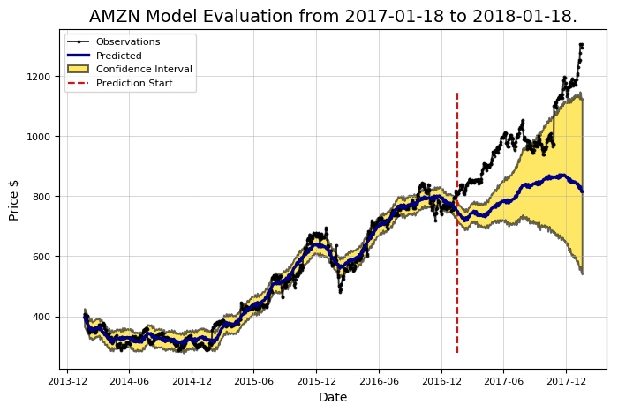

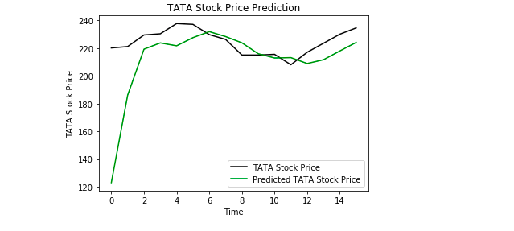
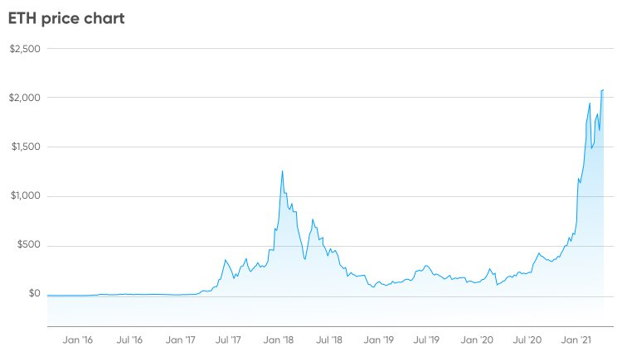
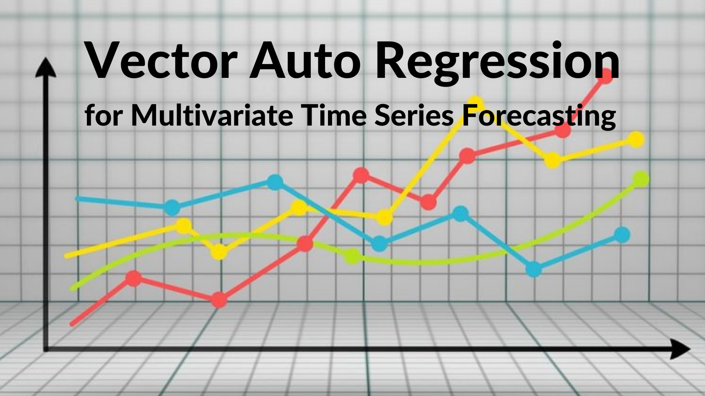

Many researches….

Slide 5
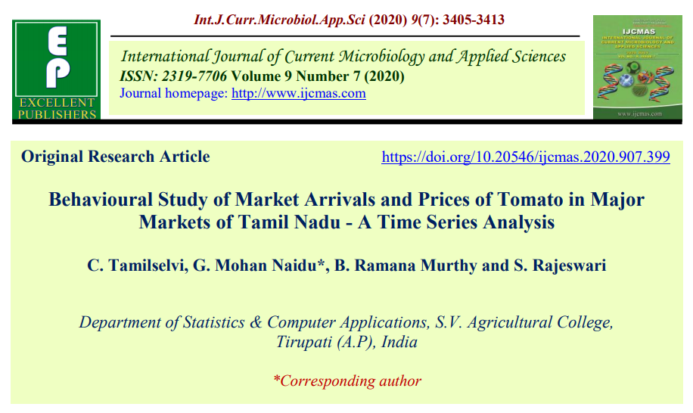
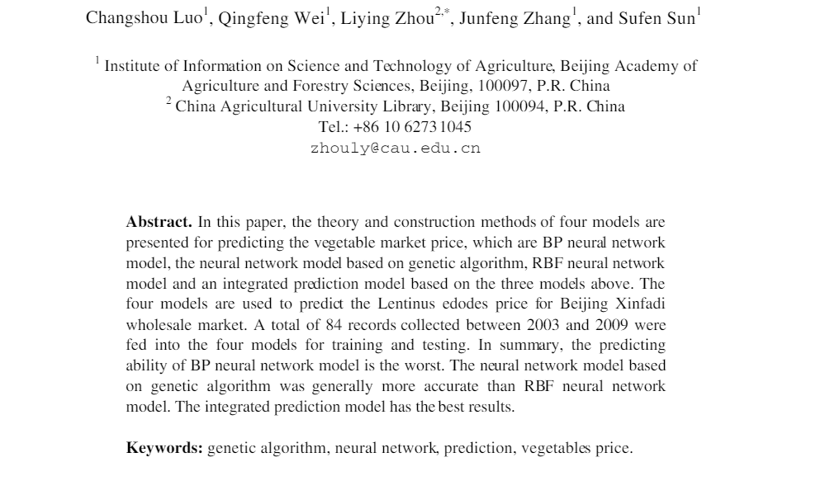
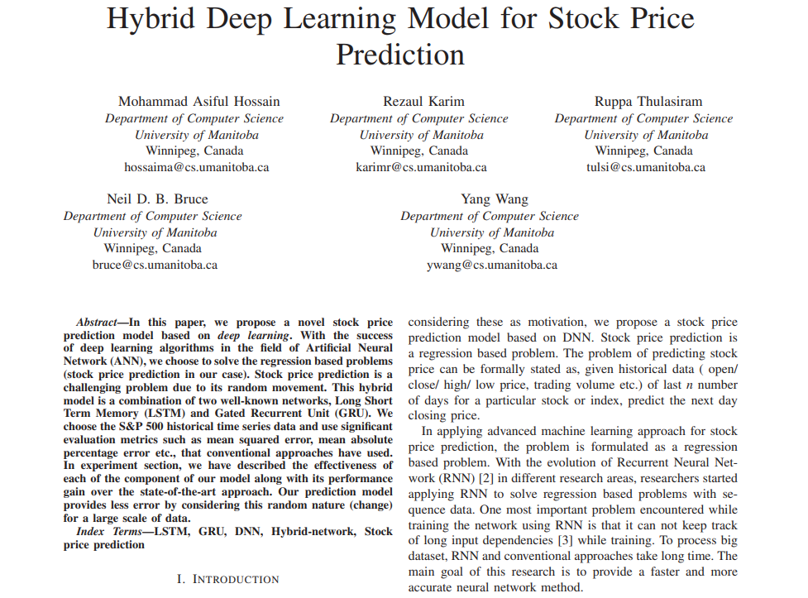
Tomatoes price prediction in Coimbatore Market India
Lentinus edodes price prediction for Beijing Xinfadi wholesale market
Hybrid Deep learning model for the Stock price prediction

Slide 6


Our Planning Solution…

Slide 7



Slide 8



Slide 9


Slide 10
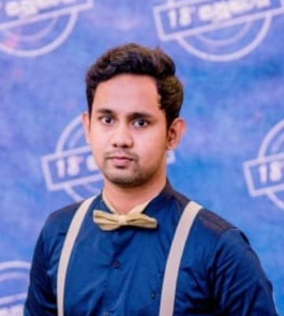

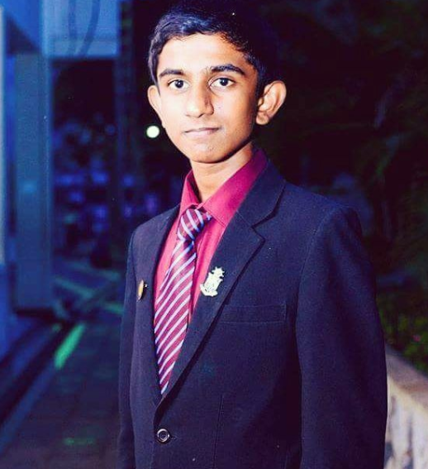
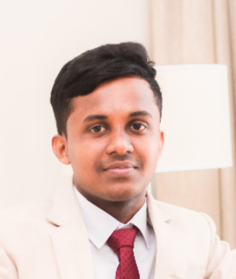
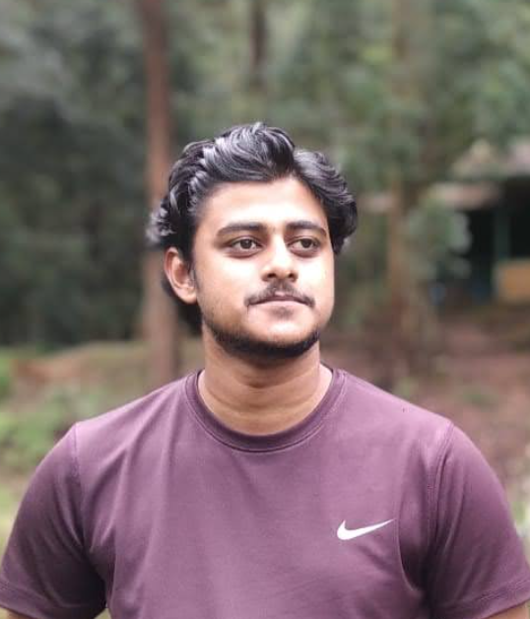

Our Team
Sasmith Ramasinghe
Maraph Darmawardana
Senal Kariyawasam
Yasiru Rashan
B.T.T. De Silva
Vihanga Jayasinghe

